Slide 2
Timesheet and Statusing
Microsoft Project 2010 Ignite

Slide 3
Agenda
Supported modes of Time and Task Status Entry
Time and Task Status Entry Configuration
Reporting
Exchange Server Integration

Slide 4

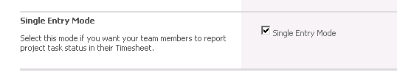
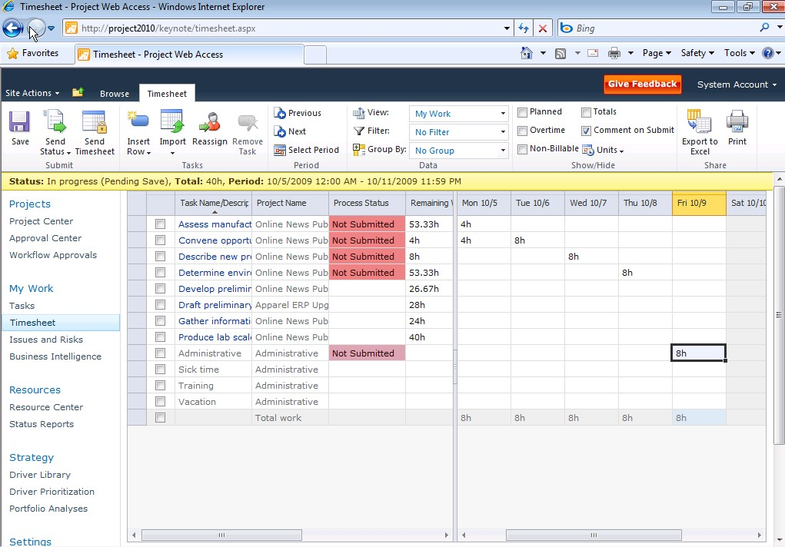
Enhanced Collaboration and Reporting Simplified single entry mode for time reporting and statusing
Improved user experience
Single entry mode to unify timesheet entry and task statusing
Consolidated Approval Center
New User Delegation
Single Entry Mode Option
Improved Timesheet Experience
Notes:
4

Slide 5
DEMO
Timesheet and Statusing User Interface

Slide 6
Supported modes of time entry

Slide 7

Three Modes of Time entry
Minimal data entry overhead
Integrated Work - Single Entry Mode
Two views of actual work
Plan
Timesheet
Tasks
Approved work goes to the plan
Timesheet
Approved work goes to the Timesheet
Single Entry Mode
Approved work goes to the plan and to the Timesheet
Import from Timesheet
Import from My Tasks
Project Task Assignments only
Admin time, Personal Tasks and Billing Categories
Integrated line approvals
Standalone Timesheet line approval – New!
Standalone Task Assignment approval
No import required
All line types and billing categories supported

Slide 8
Minimal Data Entry
May be the best option for organizations where time is not billed, and most work takes place through task assignments as there is little need to capture 100% of the team member’s time
Just task updates
Lightweight option for project task progress tracking
Integrates with Microsoft Exchange
Outlook
Outlook Web App
Outlook Mobile Access (future version)
Notes:
In organizations where time is not billed, and there is no need to capture 100% of the team member’s time using the My Tasks page should suffice. The My Tasks page together with a tracking mode like actual work completed and remaining work represents a very light-weight option for project task progress tracking.

Slide 9
Integrated Work (Single Entry Mode)
Team Member selects Timesheet option and enters their actual work as hours/day against one or more task assignments, admin time categories, or personal tasks
The timesheet will show overdue tasks, tasks with planned work in the period and default admin time
Tasks option can be used to provide a global view of all tasks
When the timesheet is submitted it becomes a permanent record of the work
Admin Time fully integrated
No need to use “Plan Admin Time” UI as in previous versions
Notes:
Integrated TimeSheets
This is the most popular configuration—the Project Management Office has enabled Single Entry mode in the Timesheet Settings section of the Server Settings page. The team member selects the My Timesheet option and enters their actual work as hours/day against one or more task assignments, admin time categories, or personal tasks.
Once the actual work entered against task assignments is approved by the status manager the work flows automatically onto the project plan. The actual work entered in the timesheet is typically consistent with actual work for project tasks –as a result, there is a single set of books. When the timesheet is submitted it becomes a permanent record of the work entered at that point and can only be changed by recalling and resubmitting or by line adjustment, even if the related project task assignments change.

Slide 10
Why Single Entry Mode?
Customer Feedback
Integrated Timesheet and Task Update entry experience enhanced in Project Server 2010
Richer User Interface and simpler user experience
Single Entry Mode option combines the best of Timesheet mode and Tasks mode
Puts “in flight” status data (including line status) in the Reporting and OLAP databases

Slide 11
Two Views of Actual Work
Useful for organizations that want to recover their costs through time-based billing; single entry mode may not be a desirable option for fixed-cost contracts
Separate Task Updates from Timesheets
Work does not automatically flow between Task Updates and Timesheets although bi-directional import options are available
New capability: Status Manager can approve timesheet lines as well as task updates (new)
Satisfies both needs: to drive the project plan and to accurately bill the customer
Verify that both sets of data, (Tasks and Timesheets) with or without importing gets to Reporting database
Notes:
This configuration is popular with organizations that recover their costs through time-based billing. The previous configuration can sometimes cause issues when working on fixed-cost contracts or when “notional time” is used to bill for intellectual property usage as the data can distort project plans. These issues can be avoided by using the Tasks page to capture work done against the project and the Timesheet page (or the underlying task tracking and timesheet API) to capture the full record of the team member’s activities.
Work does not automatically flow from one to the other (although bidirectional import options are available to reduce double entry) allowing the organization to keep “two sets of books” and thus satisfy both needs: to drive the project plan and to accurately bill the customer.
This scenario is enhanced in Project Server 2010 with the new ability to have Status Manager Approval for timesheet lines as well as task updates.

Slide 12
Standalone Time Capture
Timesheet page can be used without any task updates
Admin Time categories and Personal tasks
Ideal for capturing “operational work”
Understand where the team’s time is going
Notes:
If an organization wants to take advantage of the rich timesheet functionality in Project Server 2010 then the Timesheet page can be used without any task updates flowing onto the project.
This enables the team member to log their time and make it available for reporting and billing purposes.

Slide 13
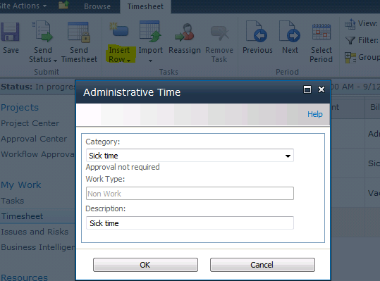
Administrative Time
Team members may add any additional categories to their active timesheet by using Add Line/From Administrative Tasks.
Notes:
In Project Server 2010 admin time is fully integrated into the Timesheet and Single Entry Mode user interfaces—no need to “Plan Admin Time” as in the previous release. The team member just enters planned time in advance and then records regular work when the time is used.
Administrative is the default working admin time.

Slide 14
DEMO
Timesheet and Statusing Process Walkthrough
Notes:
Site Administrator configures agreed upon mode of time tracking
Cover the following topics ( time allowing):
Record time against task assignments
Record working admin time
Record nonworking admin time
Record time against personal tasks
Navigate between periods
Interact with task status manager using comments
Interact with timesheet manager using comments
Submit all or selected lines for task status manager approval
Submit all or selected lines for timesheet line approval
Submit timesheet to default timesheet manager
Submit timesheet to non default timesheet manager

Slide 15
Time and Task Status entry configuration

Slide 16
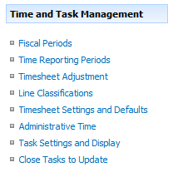
Configuration
Settings
Fiscal Periods
Time Reporting Periods
Line Classifications
Timesheet Settings and Defaults
Administrative Time
Task Settings and Display
Adjustments
Timesheet Adjustments
Close Tasks to Update

Slide 17

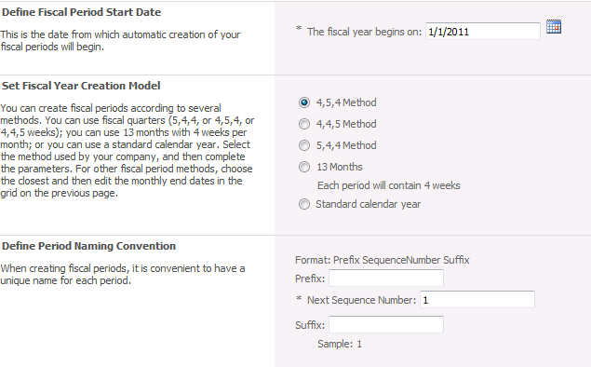
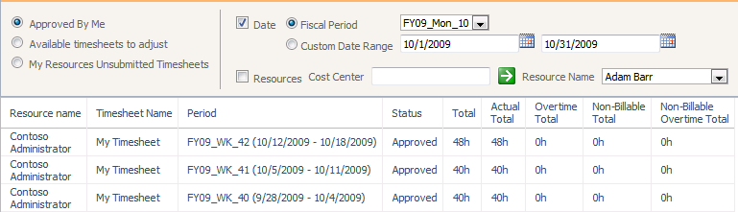
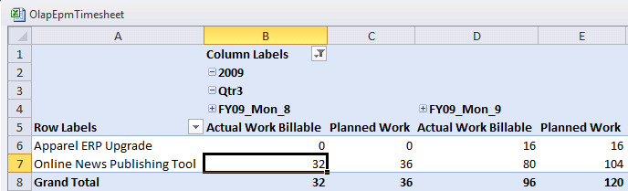
Configure Fiscal Periods
Fiscal Periods are used in timesheet adjustments and enterprise reporting

Slide 18
Configure Time Reporting Periods
Time Reporting Period setup is required prior to using the Timesheet functions in Microsoft Project Server 2010
Not required for Tasks UI
Server Settings -> Time Reporting Periods (Under “Time and Task Management” heading)
Recommended: create at least a year’s worth of time periods

Slide 19
Configure Line Classifications
Timesheet line classifications are designed for organizations that either have more overtime classifications than just billable and non-billable or organizations that wish to capture additional details about project tasks.
Examples of uses:
Multiple Overtime Classifications:
Companies who utilize SAP’s Activity Types may have overtime classifications for all work that include classifications such as Premium Time, Holiday Time, Double Time, etc. This can be modeled in Project Server by employing Timesheet line classifications that are equal to the corporate activity types.
Additional Detail on Project Tasks:
Companies who may wish to track when time spent on a task is for the purpose of bug fixing or maintenance vs. undocumented scope (AKA scope creep) vs. regularly planned work.

Slide 20
Timesheet Settings and Defaults
Timesheets can be configured in a number of ways that apply business rules to how users are allowed to track time
This applies to the Single Entry Mode, new to Project Server 2010, or to the standard Timesheet
Examples are:
Ability to turn on or off Overtime tracking
Establish the default display units for the timesheet between hours or days

Slide 21
Line Level Approvals
PWA Server Settings -> Timesheet Settings and Defaults
Activated by selecting option to Allow Coordination from Project Manager on timesheet line items in the Timesheet Options area.
My Timesheet dialog box, Team Members can submit project task assignments to the Task Status Manager for approval, previously only the whole timesheet was available for approval.

Slide 22

Configuring Single Entry Mode
Project Web App -> Server Settings -> Timesheet Settings and Defaults
Set it and forget it!
Notes:
Don’t flip flop this setting without ensuring all lines & TS pending approvals are approved/rejected.

Slide 23
Configure Administrative Time
Administrative time categories enable customers to track time spent on activities outside of project tasks
The default Project Server configuration includes categories for Sick, Vacation and Administrative time
Things to consider when dealing with administrative time categories:
Does the organization require approvals before team members can assign time to the category? Vacation might be a reasonable example of the need for prior approval
Should the administrative category appear on the timesheet each period regardless of whether or not the team member has, in advance, logged any time against the administrative category
Does the use of the category negate the ability for team members to perform work such as when on vacation or when out sick, or can the team member also perform project task work such as when scheduled to attend team meetings

Slide 24
Task Settings and Display
Tracking Method
The tracking method controls which task status fields on the My Tasks page are enabled for entry
In Single Entry Mode the tracking method setting is ignored
Always “Hours/Day” for auto-scheduled tasks
Reporting Display
This setting is used if your tracking method is set to Hours of work done per period
This setting determines whether you enter a value by day or by total hours for the period
Protect User Updates
Only allow task updates via My Tasks and My Timesheets: controls where task updates can occur and prevents the project manager from changing actuals (but can delete tasks).
Import all timesheet line classifications: includes non-billable time and non-standard timesheet line classes in the synch to Task update data
Define Near Future Planning Window
This setting determines the size of the Near Future group in the Planning Window grouping within My Tasks
Notes:
These four configuration settings control behavior for the My Tasks function.
Tracking Method
The tracking method controls which task status fields on the My Tasks page are enabled for entry. By default, this method is controlled by the default set in the project plan. However, a check box is provided to enforce the use of a single tracking method for all projects on the Project Server instance.
In Single Entry Mode the tracking method setting is ignored.
Reporting Display
This setting is used if your tracking method is set to Hours of work done per period. This setting determines whether you enter a value by day or by total hours for the period.
Protect User Updates
This setting controls where task updates can occur. If the Restrict Updates to Project Web Access check box is selected, then a project manager cannot update actual work values within Microsoft Project Professional. If Time entry by Timesheet only is selected, then task updates must be performed in My Timesheet and imported back into My Tasks for submission.
Import all timesheet line classifications – can lead to negative numbers if data is edited in the Tasks UI (or Exchange), so user training required if this setting is activated
Define Near Future Planning Window
This setting determines the size of the Near Future group in the Planning Window grouping within My Tasks. By default, this value is set to 2, as research indicates that most people seemed to plan up to two time reporting periods in advance. However, it can be increased or decreased based on organizational need.

Slide 25

Near Future Planning Window
New option to customize number of time periods ahead
Tasks which start after the current time reporting period but on or before the end of the number of time reporting periods defined in “Task Settings and Display” will be considered Near Future
By default, this value is set to two periods => tasks starting within the next two time reporting periods will be in the Near Future group
All tasks that start beyond the Near Future number of time reporting periods are placed in the Distant Future grouping

Slide 26
Close Tasks to Update
Block or restrict team members from entering additional time on individual tasks
Three basic reasons customer will choose to use this feature:
Financial closure at end of purchase order
Project Phase control
Restricting top-level time entry on a per-project basis (global setting too coarse)
A project task that has been closed to updates will not show on the team members list of tasks to which they are assigned in the “Tasks” page or on the timesheet once the task is flagged and the project gets published.
Tasks are individually selected (including the top-level project summary task)
Notes:
Consider using the “Publish” flag as well

Slide 27
Surrogate Timesheets
No longer supported in Project Server 2010, their functionality is superseded by the Delegate function
The My Tasks and My Timesheet dialogs are fully functional in Delegate mode
Statusing API now has a “impersonation free” option
Delegation extends through to Approval Center and beyond
Includes timesheet approval
No need to take ownership & republish!

Slide 28
DEMO
Time and Task Management
Notes:
Review the following:
Manage Fiscal Periods
Configure time reporting periods
Configure timesheet line classifications
Configure timesheet settings and defaults
Configure administrative time categories
Configure task settings and display
How and why to close tasks to update

Slide 29
REPORTING

Slide 30
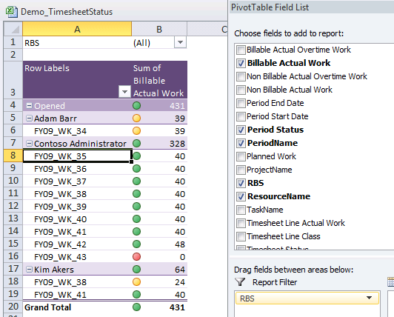
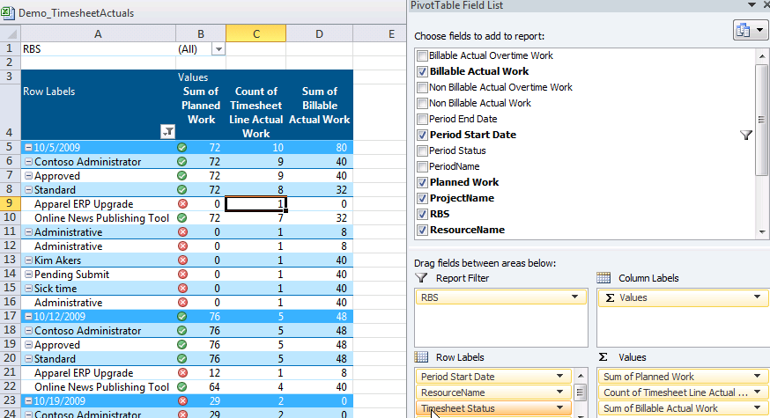
Out of the Box Reporting Templates
Reporting Database
Timesheet
TimesheetActuals
Analysis Services Database
OlapAssignmentTimephased
OlapEpmTimesheet
OlapProjectTimesheet
OlapTimesheet

Slide 31
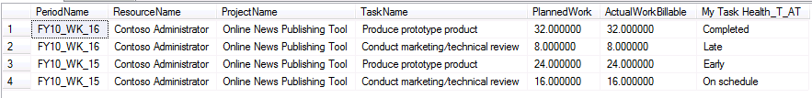
Timesheet Custom Fields
Now sent to the Reporting database!
Track other task/assignment information by period
Period | Task | My Task Health
WK1 | Task 1 | Late
WK2 | Task 1 | On Track
WK3 | Task 1 | Completed
T
IME

Slide 32
DEMO
Timesheet/Statusing Reporting
Notes:
Review the following:
Manage Fiscal Periods
Configure time reporting periods
Configure timesheet line classifications
Configure timesheet settings and defaults
Configure administrative time categories
Configure task settings and display
How and why to close tasks to update

Slide 33
Outlook/Exchange Server Integration

Slide 34
Exchange Server Integration
Allows Project Server users to view Project Server tasks in Outlook tasks
Replaces the Outlook Add-in
Removes ActiveX dependency
Requires configuration in both Project Server and Exchange Server
Can update Percent Complete or Total/ Remaining work
Does not support timesheet update
Can be used in Single Entry Mode
Notes:
Feature Information
Disposition: New | Improved
Affects: Pro | Std | PWA | Srv
PM: chboyd
Background
Project Server 2007 timesheet/task statusing integration with Outlook improved user experience by allowing assignments to be listed as Outlook tasks in addition to calendar appointments. However, an Outlook add-in was required to implement the integration which introduce client side issues such as permission assignment and the cost of integration to package and distribute a client-side update on a recurring basis as changes are introduced by service packs and hot-fixes.
Description
The following functionalities will be available in the Outlook UI:
Project tasks will appear as tasks in Outlook.
Team members will be able to see the tasks in Outlook, grouped by the project name.
Without accessing PWA, team members will be able to sync the following with Project Server:
Percentage of completions
Work done / completed
Estimates to complete / work remaining
Server-side integration - Project tasks embedded in Exchange and displayed as Outlook tasks with ability to update %Complete and Remaining Work
Lightweight integration - Instead of the heavier Outlook add-in feature, resources can enter task status using the lighter weight Outlook UI while PMs leverage the work captured behind-the-scene
Benefits
Server deployment: the Outlook add-in meant full client distribution whereas the task integration means Exchange server deployment only.
Embedded UI: Outlook task integration is more organic and natural to the user experience
Learning curve: less obtrusive integration should translate into little to no training required
FAQ
Q: Is Outlook Web Access (OWA) supported?
A: Yes. OWA (Outlook) 2010 and 2007, Exchange 2010 and 2007 SP1 are supported
Q: Is My Timesheet supported?
A: No
Q: Is My Task timesheet grid supported?
A: No

Slide 35
Configuration Steps
Configure PWA for Exchange Integration
Configure Exchange Server
Activate Exchange Server synchronization for each user

Slide 36

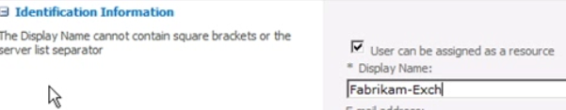
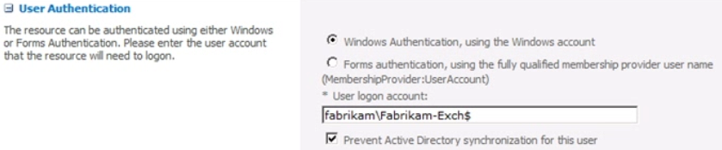
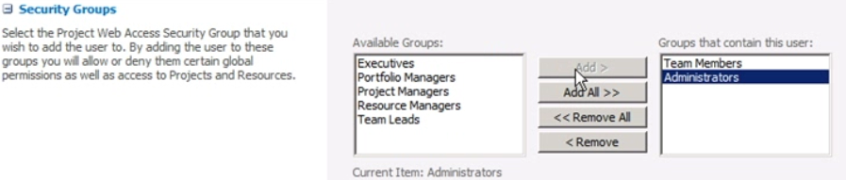
Configure PWA for Exchange Integration
Server Settings -> Operational Policies -> Additional Server Settings
Under Exchange Server Details, select “Synchronize tasks” checkbox
Create a PWA administrative user for each Exchange Client Access server talking to Project Server 2010
Notes:
PWA = Project Web Access
Each Exchange Client Access server in your Exchange farm needs a user account in PWA. This account allows Exchange to call the Project Server Exchange Web service when there are task updates that need to be synchronized. Perform the following procedure for each Exchange Client Access Server.

Slide 37

Configure each PWA user
Each PWA user that will require Exchange synchronization will need to be edited
PWA -> Server Settings -> Manage Users (under the “Security” heading)
Select “Synchronize Tasks” checkbox (in “Exchange Server Details” section)
Enter user principal name
Save settings

Slide 38
SSL Certificate Consideration
Project Server 2010 uses Secure Sockets Layer (SSL) to access the Exchange Server and must trust the SSL cert used by Exchange
If cert was issues by trusted authority (ex. Verisign), no additional configuration is needed
If cert no issued by trusted authority, export of cert from Exchange Server farm and import of cert into Project Server 2010 is required to establish trust
Notes:
Cert = Certificate
Project Server uses Secure Sockets Layer (SSL) to access the Exchange Server and must trust the SSL certificate used by the Exchange farm. If you have a certificate issues by a trusted authority such as VeriSign, Project Server will trust the certificate. If your SSL certificate has not been issued by a trusted authority, you may need to export the certificate from the Exchange farm and import it as a trusted certificate on the computer running Project Server.

Slide 39
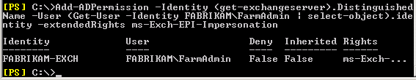
Configure Exchange Server
Configure Exchange farm administrator impersonation permissions for each Exchange Client Access Server
Notes:
Configuration of Exchange Client Access Server:
Add-ADPermission -Identity (get-exchangeserver).DistinguishedName -User (Get-User -Identity <AppPoolAccount> | select-object).identity -extendedRights ms-Exch-EPI-Impersonation
Where AppPoolAccount is the application pool account for the Project Server service application.

Slide 40


Activate Exchange Server Integration for each PWA user
Configuration performed in PowerShell (Exchange Management Shell)
Configure each Exchange user
Notes:
___________________________________________________________________
Configure each PWA user that needs Exchange integration
Add-ADPermission -Identity "<ProjUser>" -User <FarmAdministrator> -extendedRights ms-Exch-EPI-May-Impersonate
Where ProjUser is the name of the Project Server user you are configuring and FarmAdministrator is the SharePoint Server farm administrator account.

Slide 41
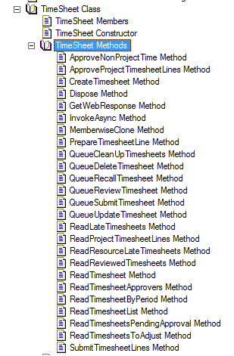
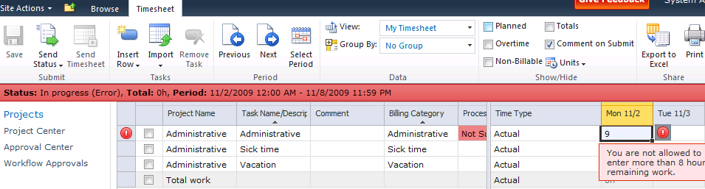
Timesheet Extensibility/Customization
Fully Accessible Programmatically
Documented Methods (Project Server Interface) in the Software Development Kit (SDK)
Extensible JSGrid web part
Step 1 Create WSS feature to deploy JavaScript to the page
Step 2 Write JavaScript to hook into the GridSatellite framework and add a post-processor validator
Step 3 Install and activate feature

Slide 42
10 Tips for Successful Deployments
Keep your process straightforward
Keep task assignments between 1-5 days long
Assign a resource to 2-4 projects at most
Audit compliance where it matters
Leverage Administrative Time for input tracking
Train your users
Don’t make the user change habits
Never forget the personal touch
Ensure that all of your users see some benefits
Reward/celebrate success and learn from failure

Slide 43
Timesheet and Statusing Resources
Videos
Time tracking and Statusing Overview
Project Server 2010 - Timesheets and Task Management Improvements

Slide 44

- Resources
Product information and trial download
http://www.microsoft.com/project
Project Team Blog http://blogs.msdn.com/project
Interactive content - Videos & Sessions & Webcasts
http://www.microsoft.com/showcase/en/US/channels/microsoftproject
http://www.microsoft.com/events/series/epm.aspx
IT Professional related
TechCenter @ TechNet http://technet.microsoft.com/ProjectServer
Admin Blog http://blogs.technet.com/projectadministration
Developer related
Developer center @ MSDN http://msdn.microsoft.com/Project
Programmability blog http://blogs.msdn.com/project_programmability
Additional questions? Project 2010 Forums!
http://social.msdn.microsoft.com/Forums/en-US/category/projectserver2010,projectprofessional2010
SharePoint 2010
http://sharepoint.microsoft.com
FORUMS
Project Professional 2010
General Questions and Answers
Project Server 2010
General Questions and Answers
Setup, Upgrade, Administration and Operation
Customization and Programming

Slide 45
Summary
Intuitive User Interface for Time and Task Entry
Able to capture projects, operations, and administrative time
Optimized performance and administration
Extensible to support Line Of Business Integration and custom business rules

Slide 46

© 2009 Microsoft Corporation. All rights reserved. Microsoft, Windows, Windows Vista and other product names are or may be registered trademarks and/or trademarks in the U.S. and/or other countries.
The information herein is for informational purposes only and represents the current view of Microsoft Corporation as of the date of this presentation. Because Microsoft must respond to changing market conditions, it should not be interpreted to be a commitment on the part of Microsoft, and Microsoft cannot guarantee the accuracy of any information provided after the date of this presentation. MICROSOFT MAKES NO WARRANTIES, EXPRESS, IMPLIED OR STATUTORY, AS TO THE INFORMATION IN THIS PRESENTATION.

